Slide 1
Cancer – advances in treatment and The impact on underwriting and claims
Dr. Andreas Armuss

Slide 2
Agenda
Advances in cancer treatment – what is the impact on survival?
Late recurrence of cancer
Survivors of childhood cancer – what do we have to consider ?
Terminal illness – how to meet the definition?

Slide 3
Advances in cancer treatment
Newly developed drugs
Antibodies (Trastuzumab, Bevacizumab, Ipilimumab)
Tyrosinekinase inhibitors (Imatinib)
New treatment regimens - high dose chemotherapy
Identification of prognostic factors
E.g. breast cancer: Hormone receptor (HR) status, HER 2 status, markers of proliferation, p 53 gene analysis, Urokinase plasminogen activator system, etc.
Genetic profiling (on cancer specimens)

Slide 4
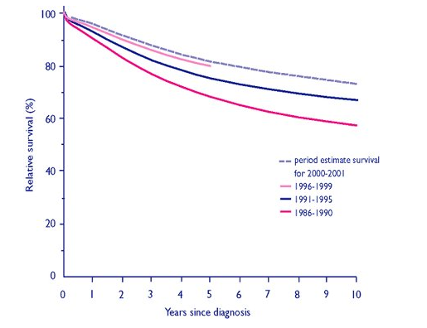
Trends in breast cancer survival UK
77%
70%
62%
From: Cancer research UK: Age standardised relative survival in women diagnosed with breast cancer, England and Wales, 1986-1999

Slide 5
What is the conclusion on this improvement?
Can we be more lenient in risk assessment in general?

Slide 6
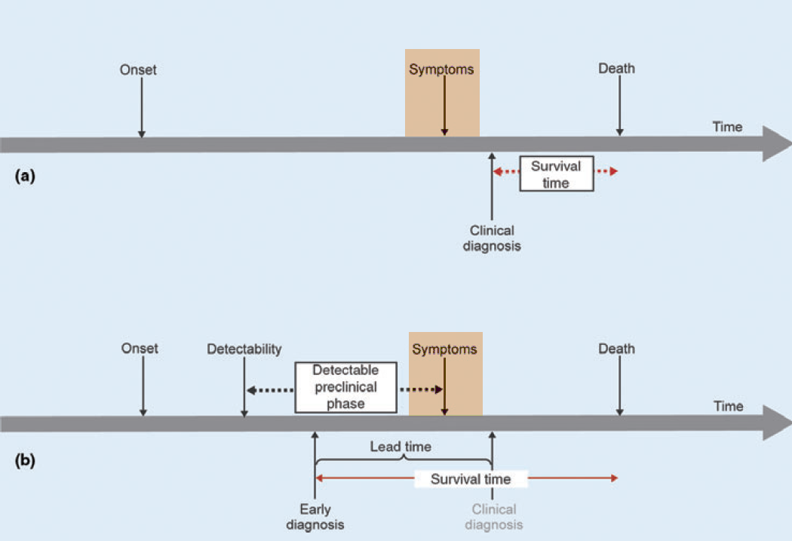
Pitfalls in interpretation of survival data
From: Dickman et al: Interpreting trends in cancer patient survival, J Int Med 2006; 260:103-117

Slide 7
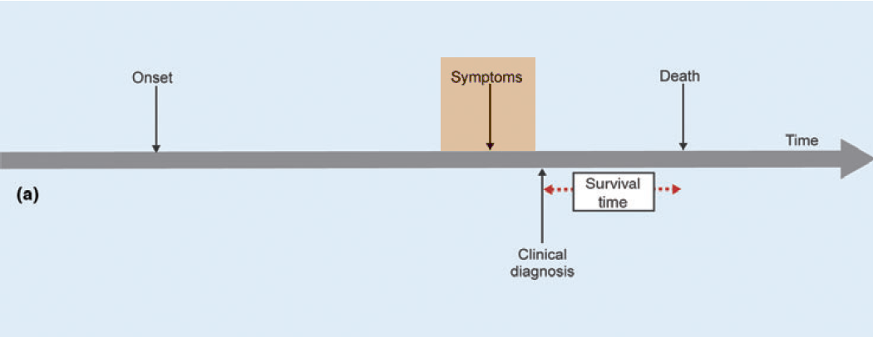
Pitfalls in interpretation of survival data
From: Dickman et al: Interpreting trends in cancer patient survival, J Int Med 2006; 260:103-117

Slide 8
Influence of early detection
1986-1990
2000-2001
Stage I
Stage I
Excellent survival
Stage II
Good survival
Stage II
Stage III
Moderate survival
Stage III
Stage IV
Stage IV
Bad survival

Slide 9
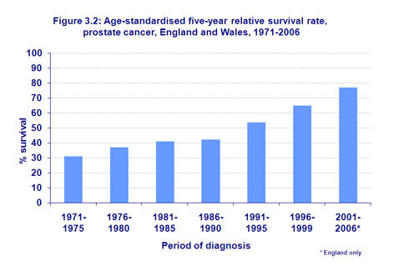
What is likely to be true? – Prostate cancer
Survival rates have improved gradually over the last decades
Most of this improvement can be attributed to the increase in incidence (PSA) and lead time bias
Any conclusions on the effect of new therapies on survival can not be accurately demonstrated
From. Cancer reasearch UK

Slide 10
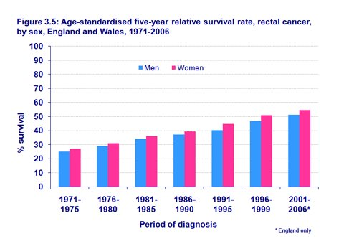
What is likely to be true? – Rectal cancer
Survival rates have improved gradually over the last decades
Improvement in local tumour control (surgery, neoadjuvant radiation) has significantly contributed to improvements in treatment
Most of the improvement of survival can be attributed to improved treatment
From. Cancer reasearch UK

Slide 11
What is likely to be true? – Breast cancer
Survival rates have improved gradually over the last decades
At least parts of this improvement in survival can be contributed to improved treatment and screening initiatives
Screening has exaggerated the improved survival due to lead time bias and over-diagnosis
From. Cancer reasearch UK

Slide 12
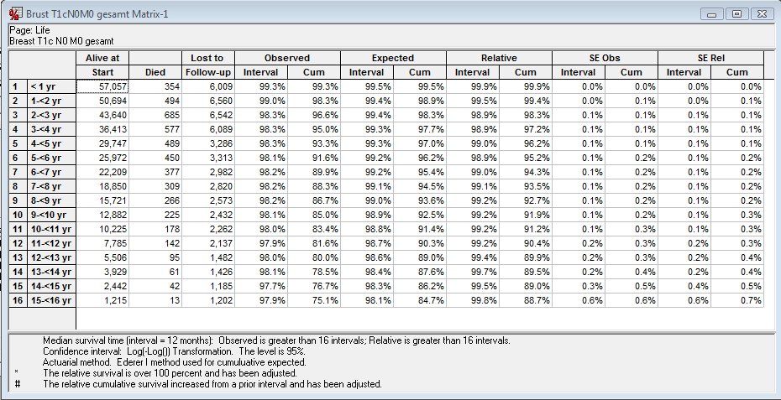
Breast T1cN0M0, age 20-64

Slide 13
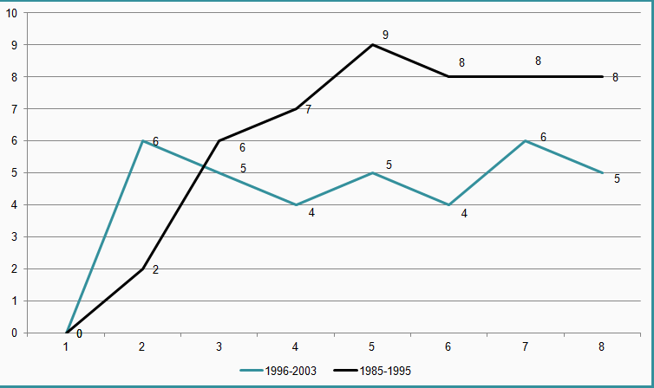
Comparison of extramortalities in breast cancer depending from time of diagnosis – T1cN0M0, age 20-49
Analysis from SEER-data
7 %o
e.m. in %o
4 %o

Slide 14
Comparison of extramortalities in breast cancer depending from time of diagnosis – T3N1M0, age 20-49

Slide 15
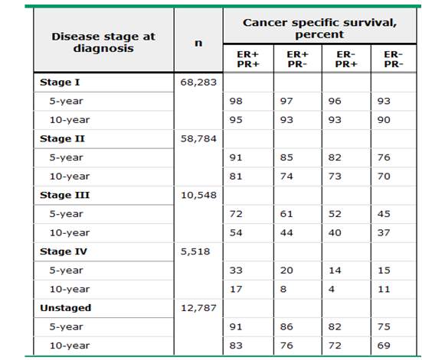
5-year and 10-year breast cancer-specific survival by hormone receptor status and disease stage
Data from: Grann, VR, et al. Cancer 2005; 103:2241

Slide 16
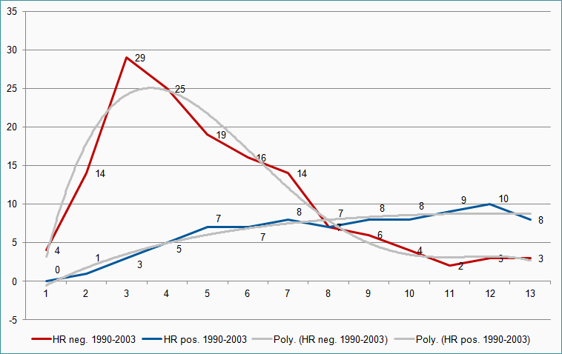
Comparison of extramortalities in breast cancer depending from Hormone receptor status – T2N0M0
Analysis from SEER-data
e.m. in %o

Slide 17
Conclusion for underwriting
Improvement in survival rates have to be interpreted with care as they are influenced by several factors and not necessarily a reflection of advances in treatment
For risk assessment mortality analysis of different cancer stages is crucial to be risk adequate

Slide 18
Late recurrence of cancer and survivors of childhood cancer

Slide 19
Long Term Course of Melanomas
Melanomas show high risk of recurrence after more than 10 years
In a study at Duke University (North Carolina, USA) among 651 long term (>10 years) melanoma survivors 168 (25%) developed recurrent disease after more than 10 years ¹
Even in thin lesions < 1mm thickness survival models suggest that 50% of melanoma related deaths occur more than 10 years after treatment ²
Ultra-late recurrence after more than 15 years is not uncommon ³
Crowley NJ, Seigler HF; Ann. Surg.1990;212:173-177
Gamel JW et al.; Cancer 2002; 95:1286-1293
Tsao H, Cosimi AB, Sober AJ; Cancer 1997;79:2361-2370

Slide 20
Melanoma Survival SEER (own extract; age 20-64, 1988-2004)
T1b ( = <1mm, Clark > III or with ulcer, N0M0), N=4526
Year after diagnosis

Slide 21
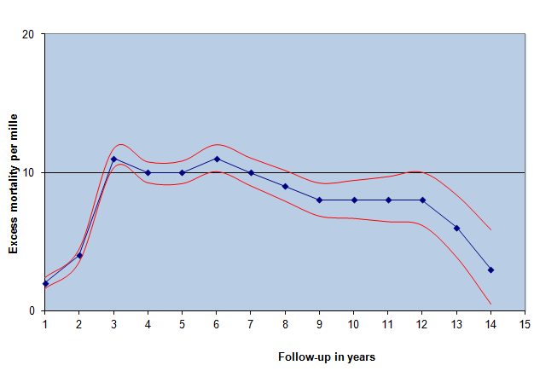
Breast T1cN0M0, age 20-64
Conf. Int. -upper limit
Conf. Int. -lower limit

Slide 22
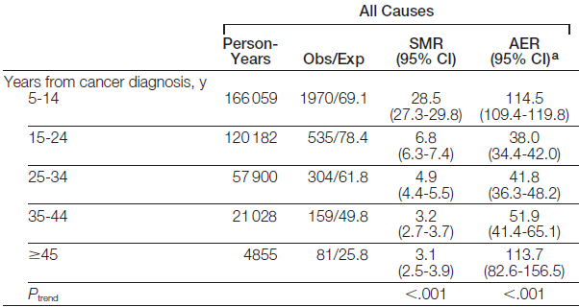
Long-term mortality among survivors of childhood cancer
From: Long-term Cause-Specific Mortality Among Survivors of Childhood Cancer, JAMA. 2010;304(2):172-179

Slide 23
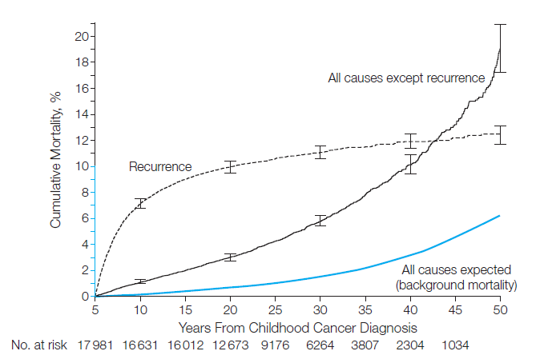
Cumulative Mortality of Causes of Death Among Survivors of Childhood Cancer
From: Long-term Cause-Specific Mortality Among Survivors of Childhood Cancer, JAMA. 2010;304(2):172-179

Slide 24
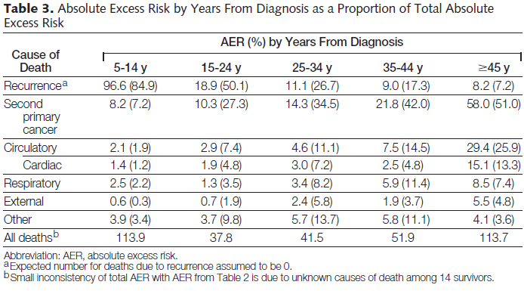
From: Long-term Cause-Specific Mortality Among Survivors of Childhood Cancer, JAMA. 2010;304(2):172-179

Slide 25
Conclusion
Availability of long-term survival data suggests that subtypes of common cancers have an increased risk of recurrence and mortality even ten years after diagnosis and therapy
Particularly survivors of childhood cancer seem to have an increased mortality throughout their lifespan

Slide 26
The problem of the terminal illness definition
Definition:
A definite diagnosis by the attending Consultant of an illness that satisfies both of the following:
The illness either has no known cure or has progressed to the point where it cannot be cured, and
In the opinion of the attending Consultant, the illness is expected to lead to death within 12 months
Interpretation:
The applicant must die within the next 12 months with a xxx likelihood
Is there any subtype/stage of cancer where a xxx percentage likelihood of dying within 12 months can be predicted?

Slide 27
Analysing using information from a survival curve
What is the probability (p) of surviving interval 2?
Answer: p (interval 2)= P (interval3)/P (interval 2) = 0,8186/0,8460 = 0,9676

Slide 28
What is the probability of dying in a specific interval
qxi = 1 -
pi
In our example: probability of dying between year 2 and 3
q2-3 = 1- 0,9676 = 0,042 = 4,2 %

Slide 29
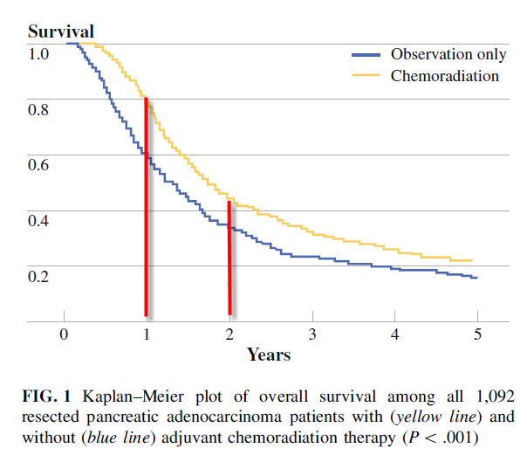
Example pancreatic adenocarcinoma
Probability of surviving year 2 after having survived year 1:
p1-2 = 0,4/0,8 = 0,5 (50%)
Probability of dying between year 1 and year 2 after having survived year 1:
q1-2 = 1 – 0,5 = 0,5 (50%)
Hsu et al: Adjuvant Chemoradiation for Pancreatic Adenocarcinoma: The Johns Hopkins Hospital—Mayo Clinic Collaborative Study, Ann Surg Oncol (2010) 17:981–990

Slide 30
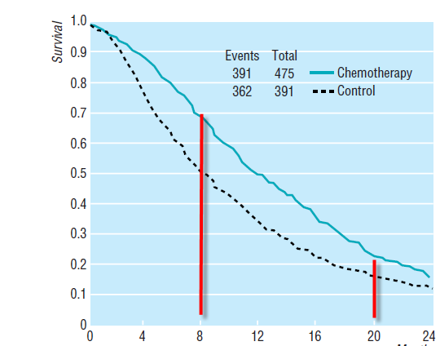
Example advanced colorectal cancer
Probability of surviving month 8-20 after having survived 8 month:
p1-2 = 0,2/0,7 = 0,29 (29%)
Probability of dying between month 8-20 after having survived 8 month :
q1-2 = 1 – 0,29 = 0,71 (71%)
From: Palliative chemotherapy for advanced colorectal cancer: systematic review and meta­analysis, The Colorectal Cancer Collaborative Group, BMJ 2000;321:531–5

Slide 31
Comparison of extramortalities in breast cancer depending from time of diagnosis – T3N1M0, age 20-49

Slide 32
Conclusion
Even in very advanced cancer stages the probability of dying within a one-year period is statistically rarely reaching a 90-100% level
An individual consideration of the prognosis is necessary to decide on terminal illness claims
For advanced cancer stages it is unlikely that progress in treatment has had a significant impact on survival

Slide 33
Thank you very much for your attention
© 2009 Münchener Rückversicherungs-Gesellschaft © 2009 Munich Reinsurance Company
Dr. Andreas Armuss

